Slide 1

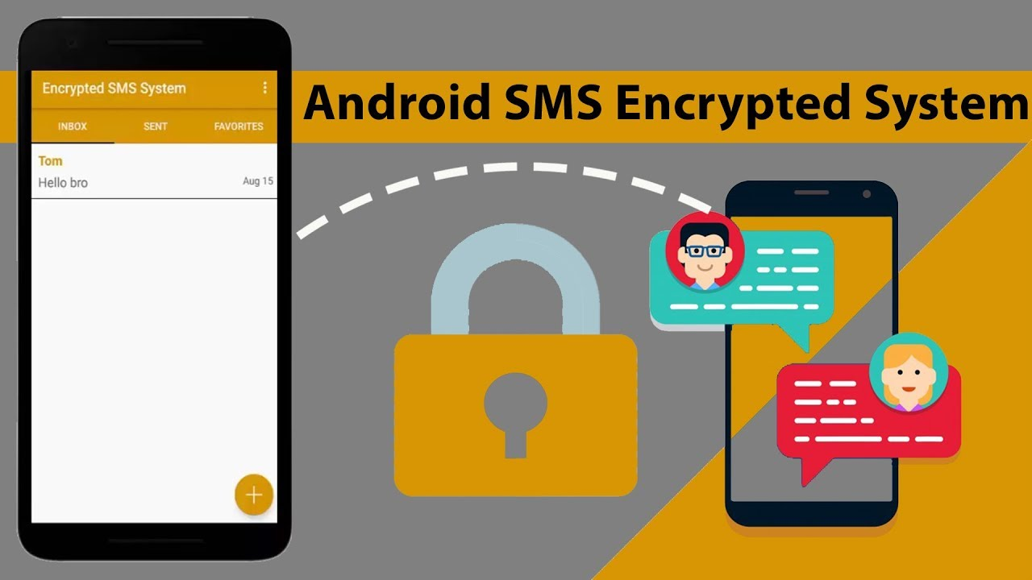
SMS Banking(Plain Text And Encrypted Text)
S.D. Praveena
MAD Lab
IDRBT

Slide 2
Overview
SMS Banking(Plain Text,Encrypted Text)
Sending plain ,Encrypted text android application
Application Demo

Slide 3
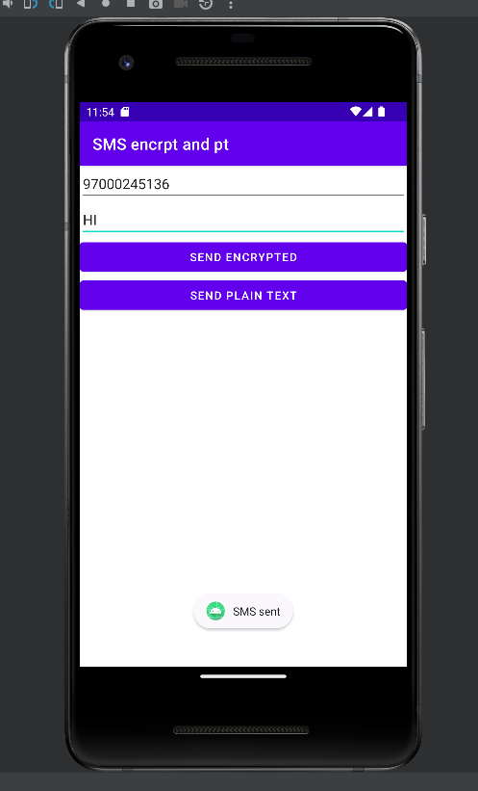
Application Demo

Slide 4
Plain and Encrypted Text Messages
Plain Text Message: A plain text message is like a regular, readable message that you can understand without any special effort.
For example, if you send a plain text message saying "Hello! How are you?", anyone who receives it can read and understand the words without needing any secret code or method.
Encrypted Text Message: An encrypted text message is like a secret code that hides the actual message.
For example, if you send an encrypted text message "Lzk82Fh9DpM=", it might look like gibberish to anyone who intercepts it. Only the person with the right decryption key can turn it back into the original plain text message "Hello! How are you?".

Slide 5
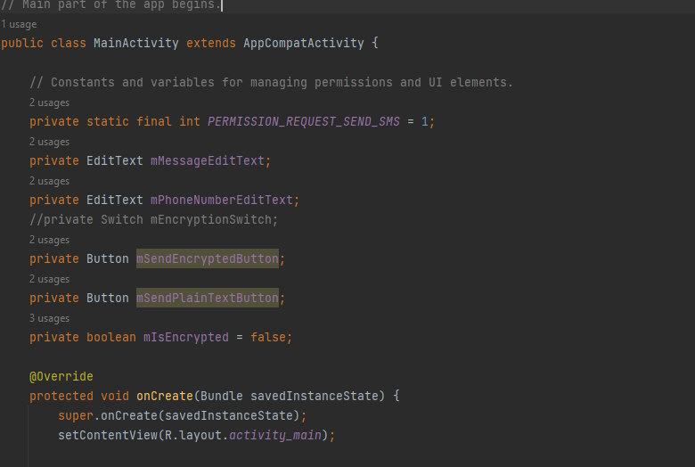
Private static final int PERMISSIN_REQUEST_SEND_SMS=1;
It is likely going to be used as a request code when requesting SMS sending permissions

Slide 6
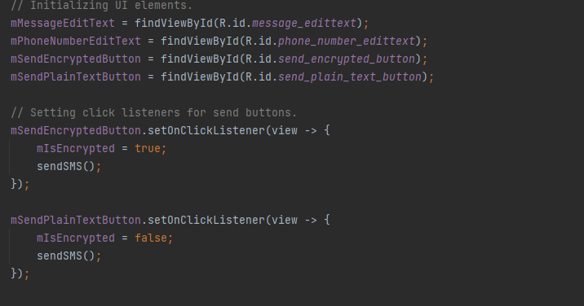
mSendEncryptedButton.setOnClickListener(view -> { ... });:
When the "Send Encrypted" button is clicked, this code block is executed.
It sets the mIsEncrypted boolean variable to true,
indicating that an encrypted message should be sent,
and then calls the sendSMS() method to handle the message sending logic.

Slide 7
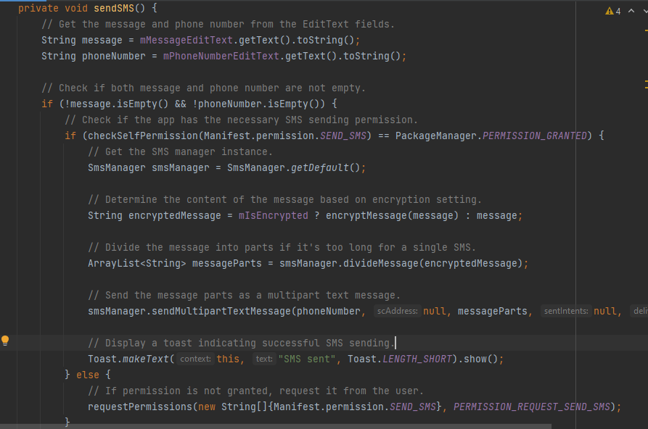
Get the msg and phone number from the EditText fields, then check if both msg and phone number are not empty, then check the sms sending permissions all are ok then indicating successful sms sending msg.

Slide 8
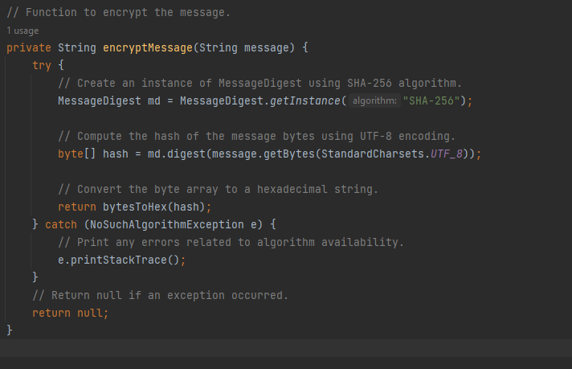
Here is the function to encrypt the message. The algorithm used is SHA-256.

Slide 9
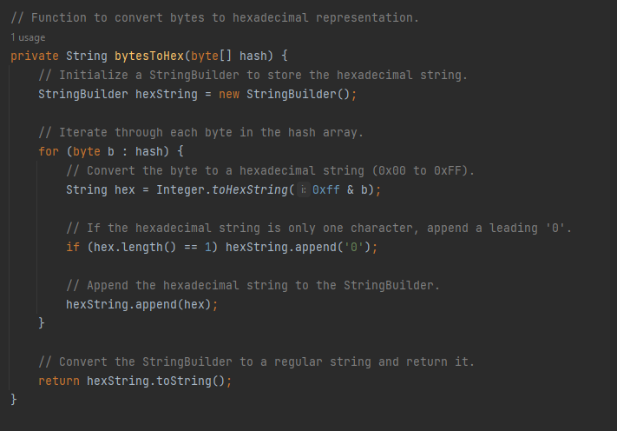
Function to convert bytes to hexadecimal representation

Slide 10
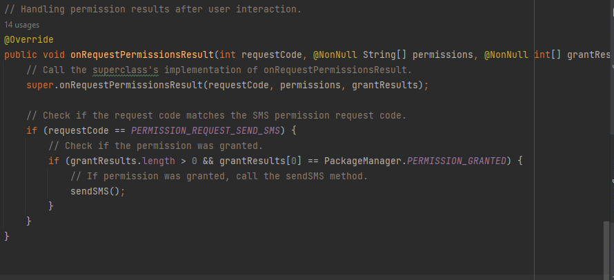
Handling permission results after user interaction

Slide 11
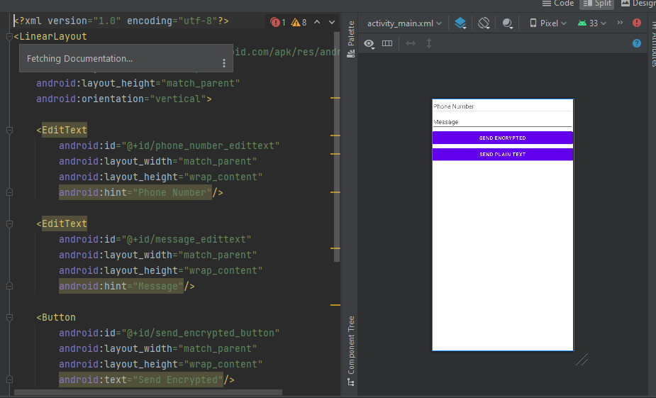
Activity_main.xml is used to design the UI for the app

Slide 12
THANK YOU

